Slide 1
Research Project Workshop 07:
Exploratory Data Analysis (EDA) & Data Visualization
June 8, 2017
Instructor(s): Letisha Wyatt, PhD

Slide 2
agenda
1 | exploratory data analysis (EDA) concepts
2 | data visualization concepts
3 | research reproducibility
4 | Playing with data in RStudio

Slide 3
learning outcomes
Understand elements of creating an effective visualization
Awareness of (free) tools
Strategies for working towards more reproducible practices
Feel comfortable with the RStudio workspace
Basic functions
Develop a plan to practice and checkout other resources [at the end of the presentation]

Slide 4
EDA & data visualization: WHO

Slide 5
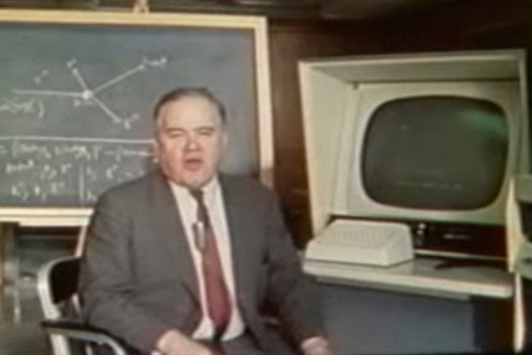
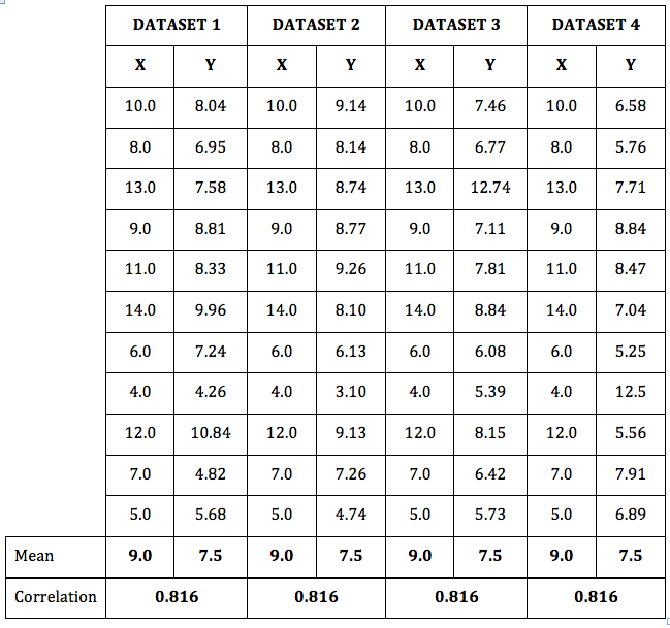
john tukey & anscombe’s quartet
American statistician
Pioneer exploratory statistics, using computers for data visualization (c. 1970)
Suggested that exploring data through visualization may present unexpected data trends
n = 11
mean(x) = 9
mean(y) = 7.50
var(x) = 11
var(y) = 4.12
correlation = 0.816
Notes:
Note: EDA happens after data cleaning aka initial data analysis
https://www.immersiveanalytics.com/2015/11/beginning-of-interactive-3d-data-visualization/

Slide 6
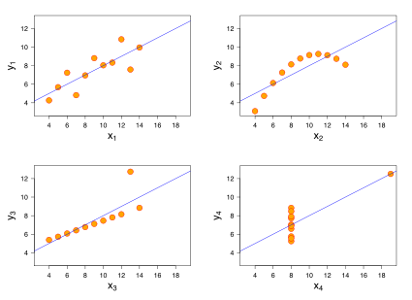
Moral of the story:
Don’t rely on just statistics. Important information can be gleaned from visualizations!
Image source

Slide 7
EDA & data visualization: WHAT

Slide 8
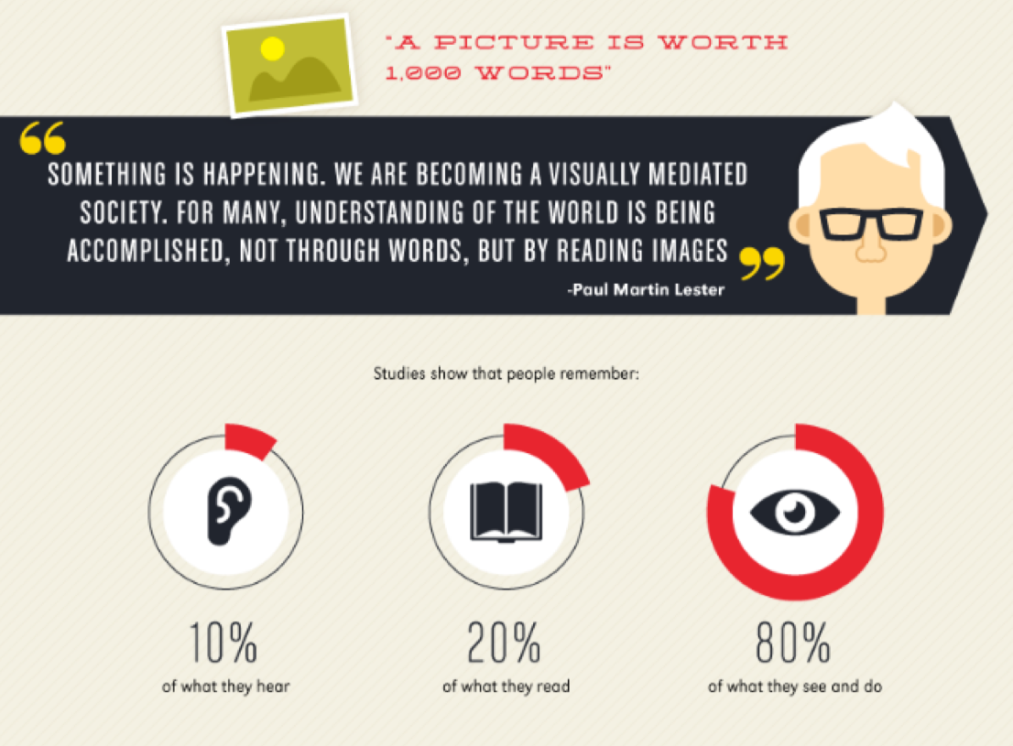
Image source
Notes:
Humans are visually inclined
tabular view of data is difficult to see trends and get key information quickly!

Slide 9
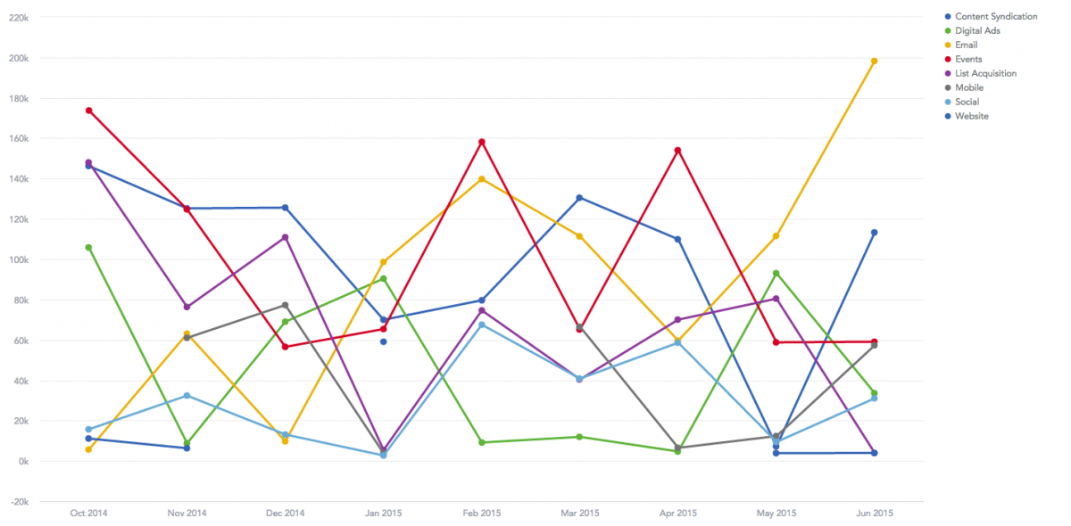
Image source
Notes:
good visualization is how we turn messy data…

Slide 10
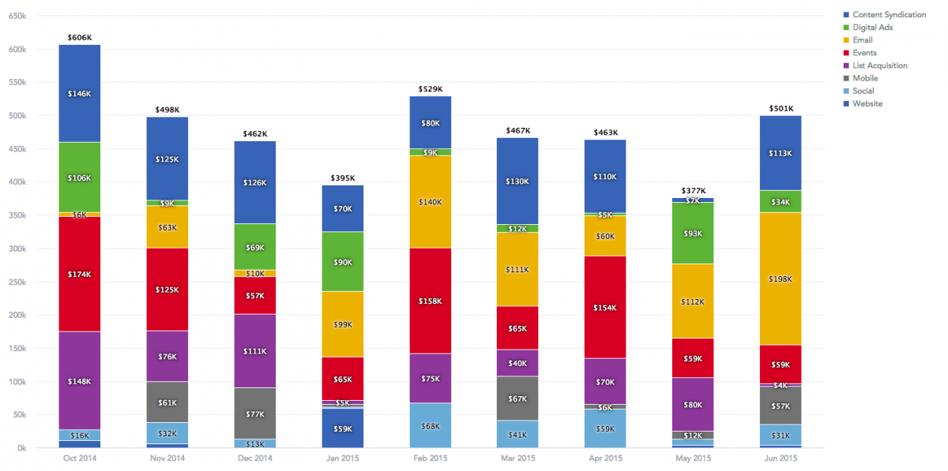

PARTICIPATE: What make this a more effective visualization?
Image source
Notes:
into knowledge. this is better but still leaves some to be desired (titles, axes labels for one…annotations – we touched on this later)

Slide 11
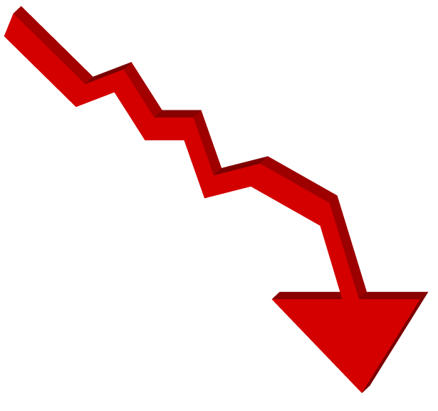
how to make an effective graphic
Be smart about color,
shapes, area/size – used for accurate representation and to make comparisons
define what you
want to say
choose your chart/graphic
organize visuals
to aid understanding
annotate for context
leave white space so as not to crowd the eye
ideally visualizations aid eye movement
Adapted from Hubspot Blog
Notes:
comparing values? show composition/distribution? relationships/trends?
organize visuals -> use color/shapes to your advantage, don’t crowd the eye, aid in movement
did you get your point across? use text to annotate visualizations for maximum clarity

Slide 12
visual saliency
Visual salience: the idea that certain parts of a scene are pre-attentively distinctive.
Is it possible to harness how our brain works to better visualize data?
Could this help others ”get” your data more quickly?
Source: Kadir and Brady, 2000
Notes:
pre-attentive meaning you don’t have to think about it

Slide 13
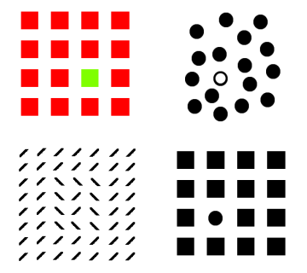
the low-hanging fruit: shape/color
Be cognizant of color selections and representations
Search color in google (e.g., what does yellow represent?)
Consider limitations of black & white printing (color prints are costly)!
Image Source: Kadir and Brady, 2000
Notes:
These are basic functions of brain aka low hanging fruit (boundaries, estimated counting)
There are a number of things that aid in visual saliency
e.g., points on a graph = shapes; lines on a graph – shapes (can be color)

Slide 14

size is harder
Image source
Notes:
Takes a little longer…We aren’t so good at estimating size/differences/area differences

Slide 15
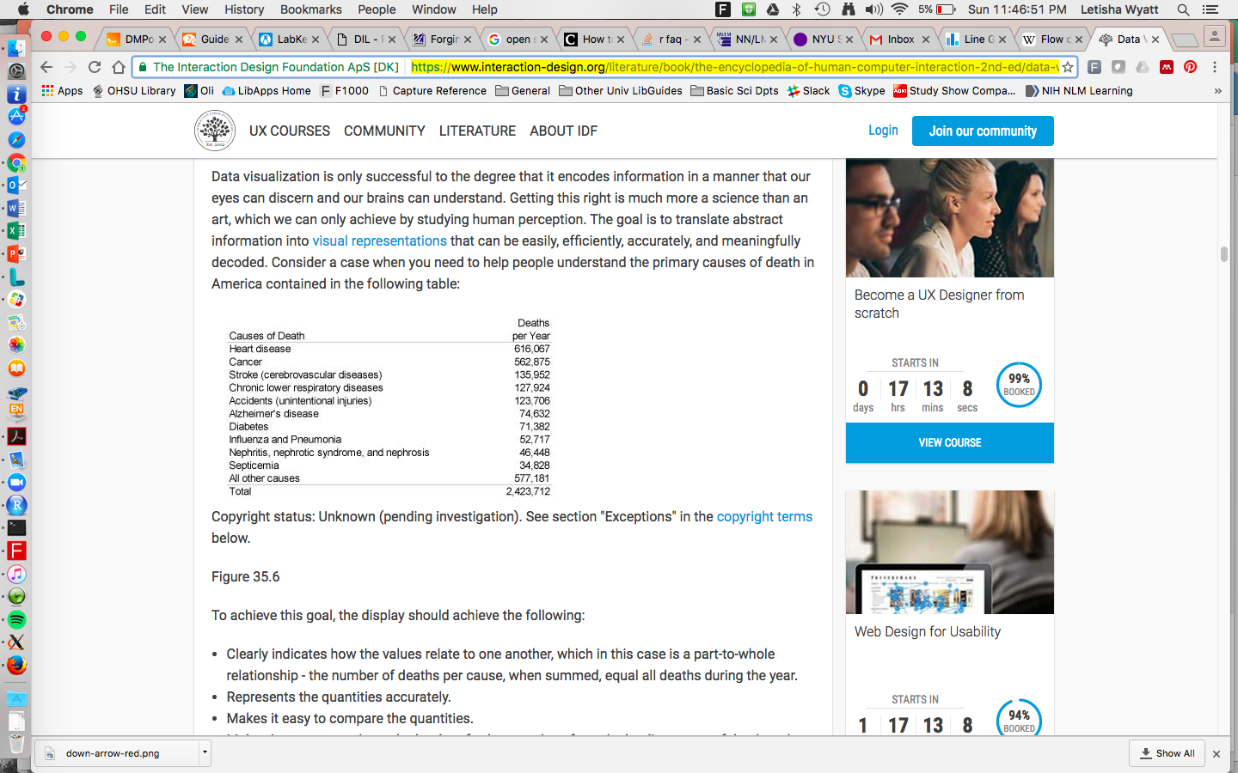
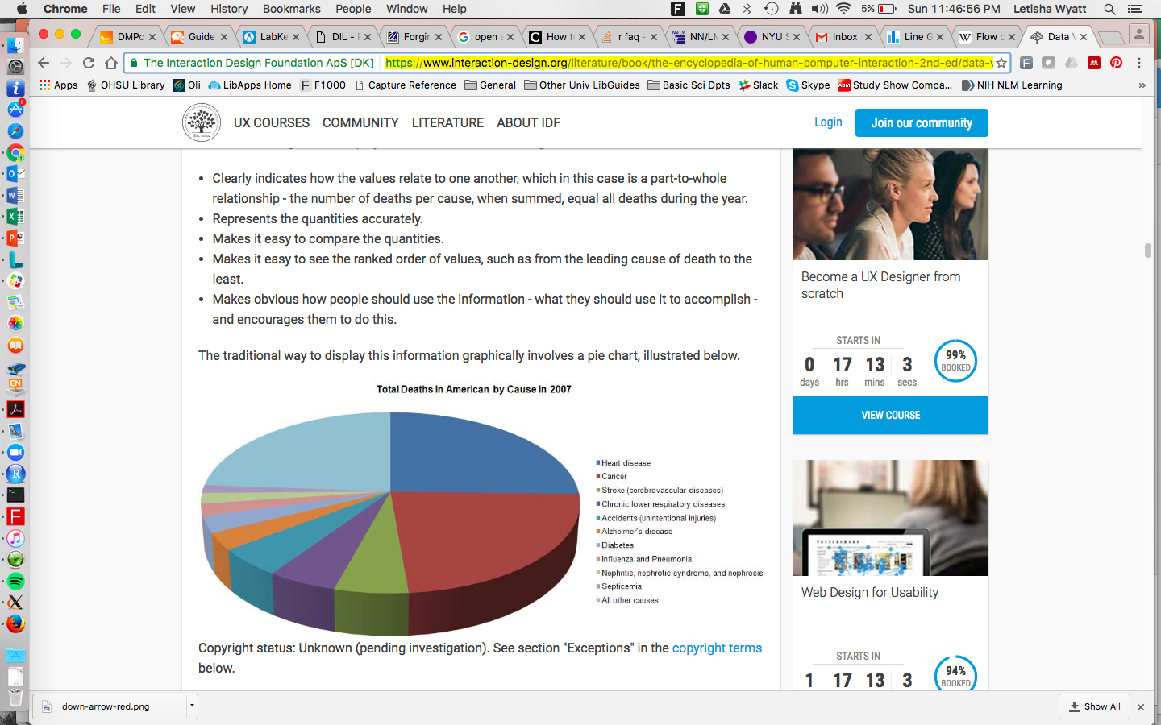
areas even harder
Image source
Notes:
quantity comparisons can be area or linear display (pie chart versus area under the curve)
Takes a little longer…We aren’t so good at estimating size/differences/area differences
We process lines better

Slide 16
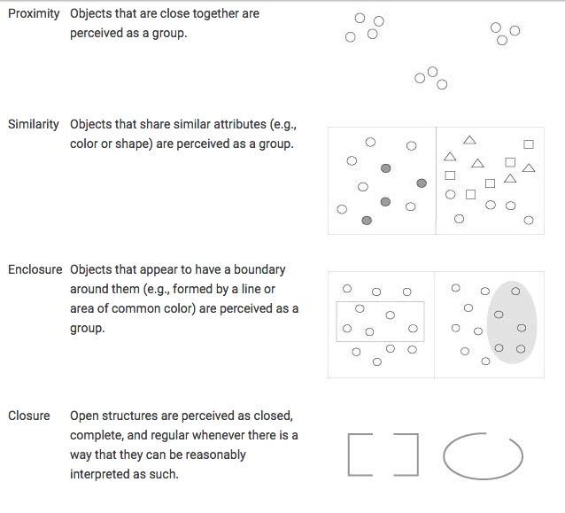
other elements of perception
Image source
Notes:
Gestalt Principles (Gestalt School of Psychology, 1912)

Slide 17
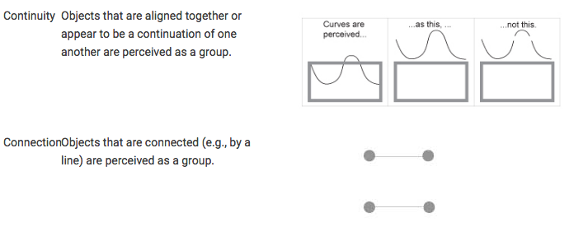
other elements of perception
Image source
Notes:
Gestalt Principles (Getsalt School of Psychology, 1912)

Slide 18
EDA & data visualization: WHEN
Notes:
when to use what visualization (or chart)

Slide 19
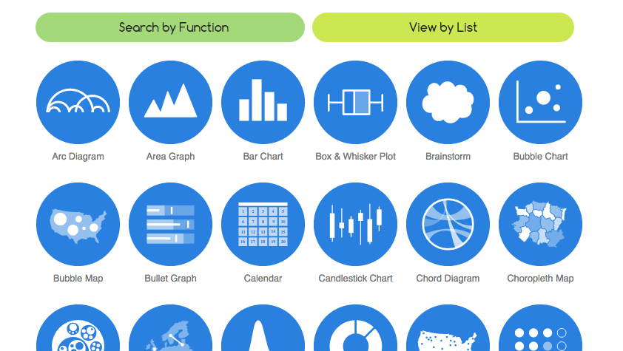
The data visualization catalogue

Slide 20
what is your message?
 | Compare Value | Composition | Distribution | Relationships | Trends
Bar | ✔ |  | ✔
Column | ✔ |  |  |  | ✔
Scatter plot | ✔ |  | ✔ | ✔
Bubble |  |  |  | ✔
Line | ✔ |  | ✔ | ✔ | ✔
Dual-Axis |  |  |  |  | ✔
Pie |  | ✔
Stacked bar |  | ✔
Stacked column |  | ✔
Source

Slide 21
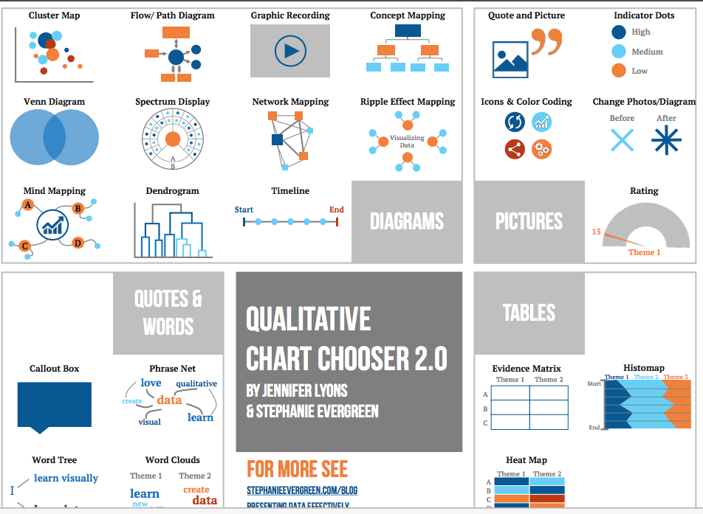
Qualitative Chart Chooser

Slide 22
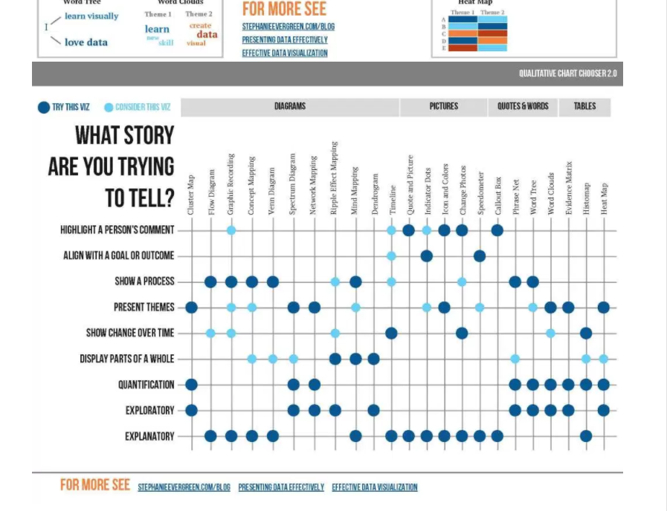
Qualitative Chart Chooser

Slide 23
EDA & data visualization: WHERE
Notes:
Tools (emphasis on free) and where to find other learning resources

Slide 24
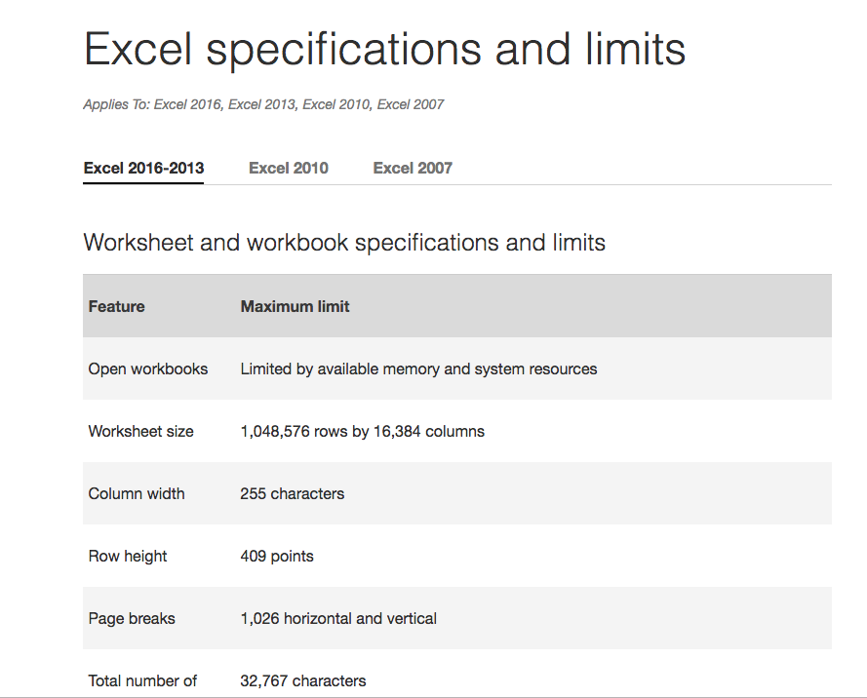
Notes:
https://support.office.com/en-us/article/Excel-specifications-and-limits-1672b34d-7043-467e-8e27-269d656771c3?ui=en-US&rs=en-US&ad=US

Slide 25
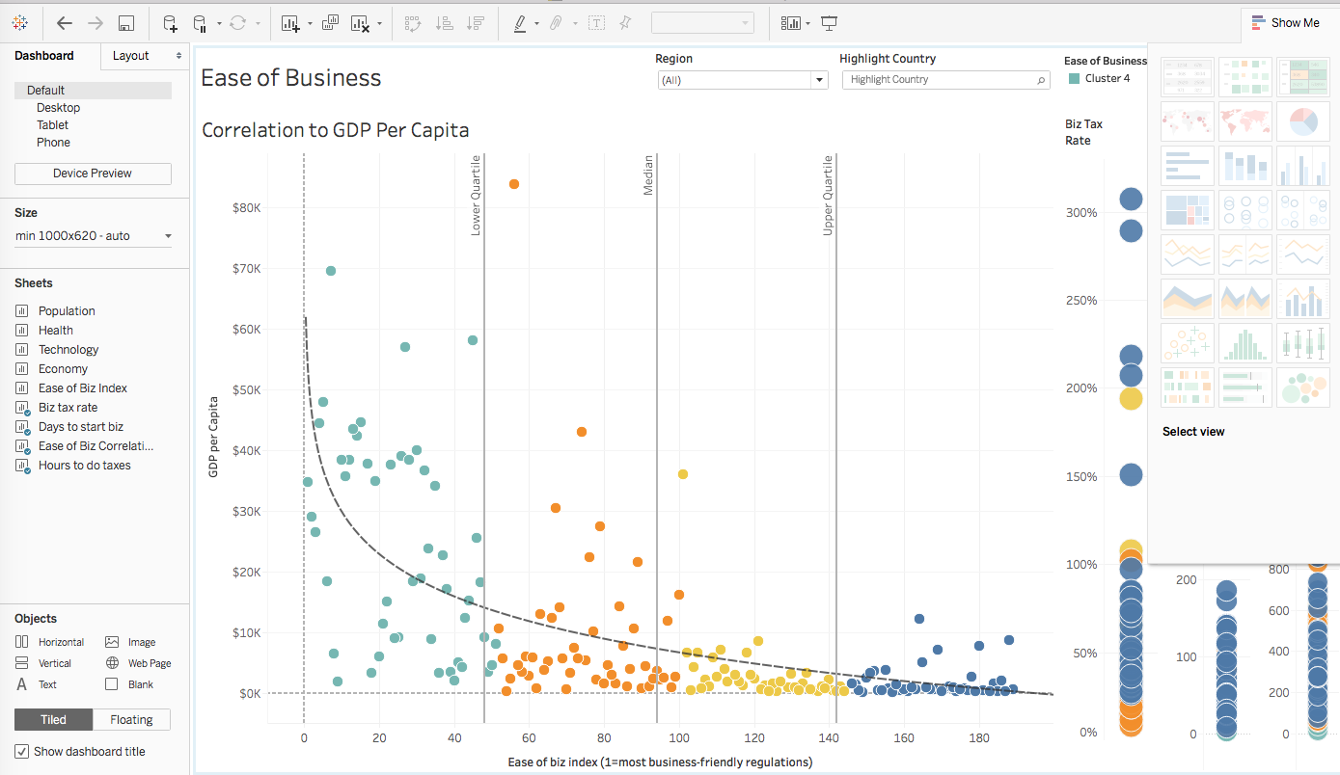
Tableau
Tableau Public

Slide 26
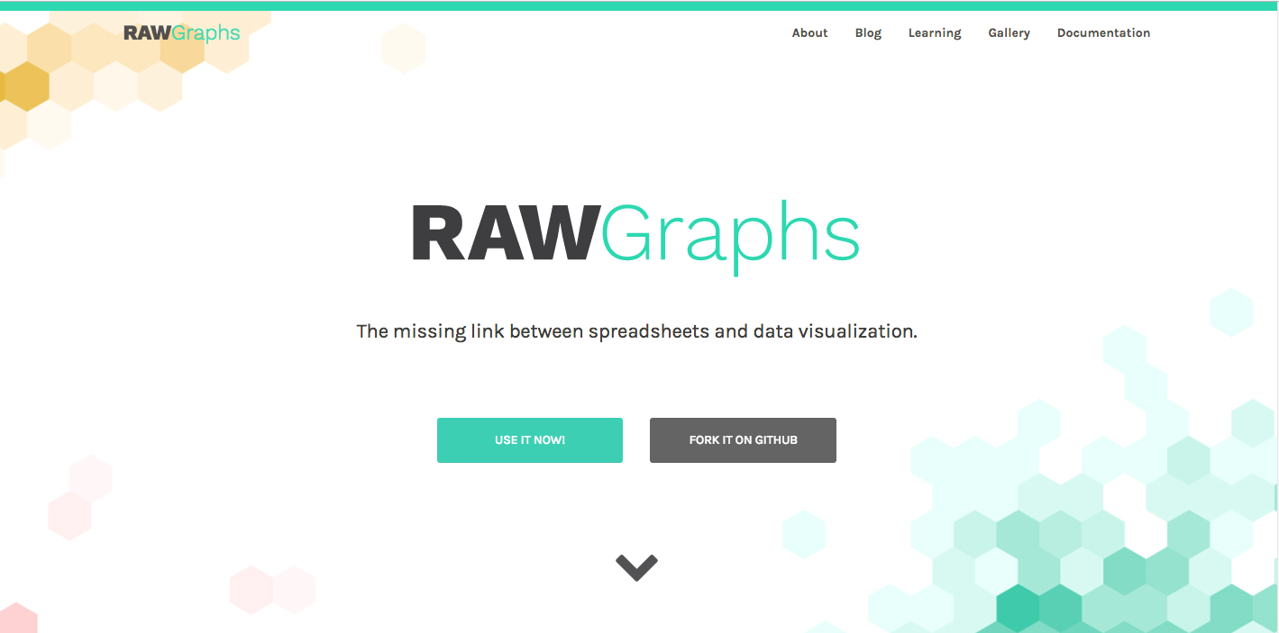
Raw Graphs
Add your data (import/copy & paste)
Choose a visual
Fine tune visualization & explore data
Export viz as SVZ or PNG files
rawgraphs.io
Notes:
disclaimer: never used! just learned about it
**recall, PNG is a “this” file format to prevent data loss!

Slide 27
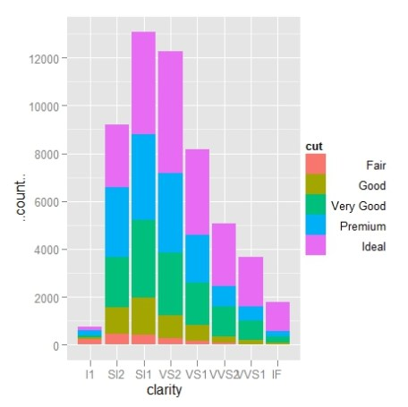
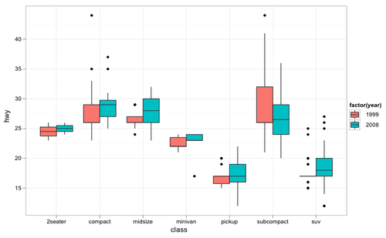
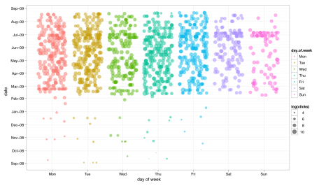
R/RStudio
YOU build visualization = reproducible
Customizable, high-quality visualizations
Data cleaning packages to automate some of the work (e.g., dplyr, tidyr)
More sophisticated statistics
Open software; easy sharing built-in

Slide 28
cleaning up the data
Formatting for any data analysis software tool is important!
Trash in = Trash out
Adequately prep your data - there are best practices…
PARTICIPATE: Clean the data in the Excel file by removing the name and birthdate columns and create variable names. Data dictionaries FTW!
Notes:
R has packages for scripting/automating cleaning your data!

Slide 29
EDA & data visualization: WHY
Notes:
who is your audience?
Don’t forget about accessibility!

Slide 30
be considerate of your audience
You’re telling a story – is your message clear?
sans serif (without feet) is great for electronic text
serif is great for print text
Wikipedia list of serif/sans serif fonts
Accessibility is often overlooked!
Color-blindness: more people than you might think are effected
Coblis
Vischeck
Dyslexia: consider using
Arial (sans serif)
Computer Modern (serif)
Open Dyslexic
Notes:
Learn more about dyslexia and typeface here: http://dyslexiahelp.umich.edu/sites/default/files/good_fonts_for_dyslexia_study.pdf

Slide 31
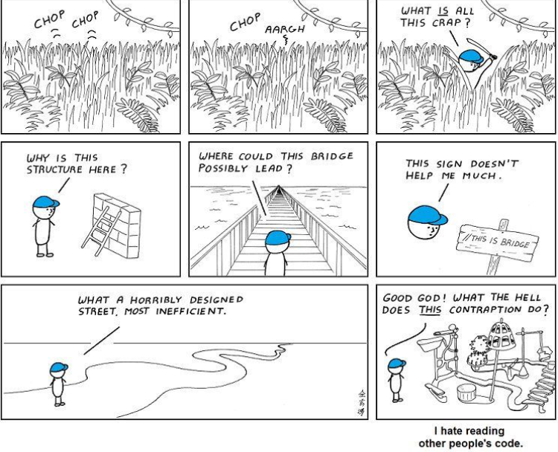
the reproducibility crisis
Notes:
YOU/colleagues are also your audience
what do folks mean about repro crisis? Why is this important? Who is involved (funders requesting more methods details, researchers needing standardization, publishers requesting data sharing, tax payers looking for cures!)
What is different between replication and reproducibility?
**review RPW02 and RPW03 where we talk about data standardization and sharing

Slide 32
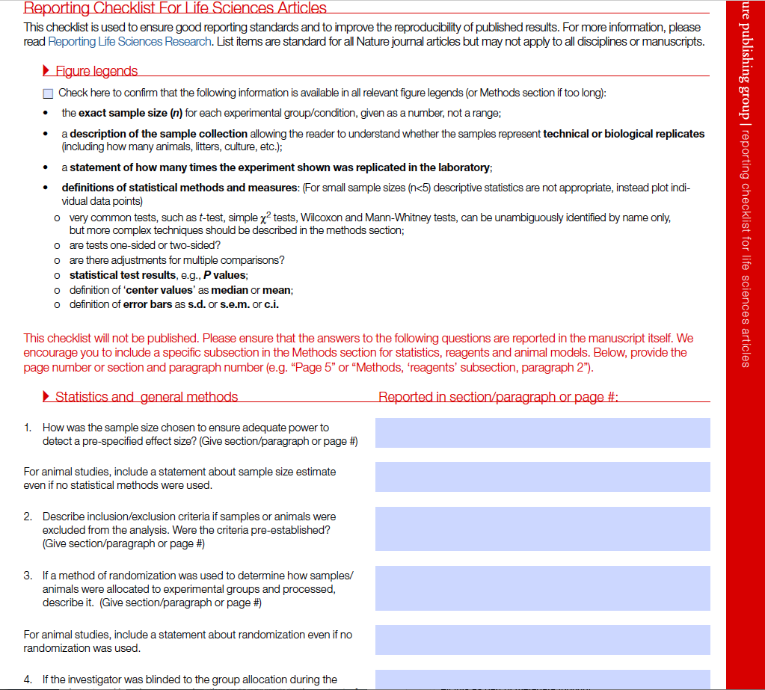
nature checklist
Adapted from: OHSU Open Educational Resources

Slide 33
reproducibility
=
well-documented & accessible
analysis (i.e., code)
methods
study
PARTICIPATE: how do data, methods, figures, experimental design, (exploratory) data analysis, and data visualization intersect within the research “reproducibility crisis”?

Slide 34
things to consider methods (or experimental procedures)
Where did the reagents/cells/animals come from (authentication of key resources)?
What were the sexes (relevant biological variables)?
What were the group sizes? How was this determined?
What is the treatment, what are the controls?
Inclusion/exclusion criteria (i.e., attrition)?
Managing bias (randomization, blinding)
How was the data analyzed (software, stats design)

Slide 35
…and the figures
First line of figure legends typically convey important finding/result
Consistent axes labels and scales
Group sizes
Variance
Error bars

Slide 36
R /RStudio installation
R (command line/terminal)
RStudio is an IDE = integrated development environment
Install R : YouTube instructional videos if needed: Mac or PC
Install RStudio Desktop
Check for updates often
Crantastic for packages

Slide 37
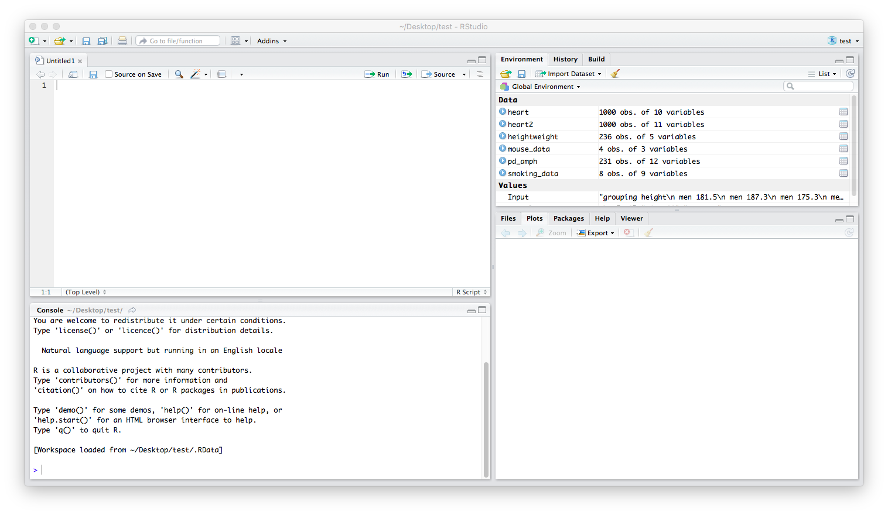
RStudio orientation - demo
Notes:
See Tools/Global Settings to customize RStudio start up options and look

Slide 38

some basics
R Projects + scripts = make you’re work organized and reproducible!
Printer
> print(“data viz”)
Calculator
> 2+2
> 3*7/(5-4)
Assignments
To create objects use the assignment operation: <-
Allows for re-using operations/calculations later
Installing & Loading Packages
> install.package(“nameofpackage”)
> library(“nameofpackage”)
Help
> ?functionname
> help(“nameofpackage”)
PARTICIPATE: Let’s create and run a script file of some of the basic functions above! See exercise worksheet.
Notes:
console is great for practicing/testing things out but the script is the powerful part - start here…test in console
installed.packages()
available.packages()
update.packages()
**general rule of thumb: use quotes if whatever you’re referring to doesn’t already exist within your workspace (i.e., is it an object?)

Slide 39
getting data into RStudio
Excel
”gdata” package
“xlsx” package
> read.xls(“filename”, sheet=1)
CSV and Webpages
> read.csv("C:/path/to/local/file.csv")
SPSS/STATA/Others
For packages and instructions, see: http://www.statmethods.net/input/importingdata.html
PARTICIPATE: Let’s explore our workspace and import some data! See the exercise worksheet.
Notes:
*Note, sheet 1 is the default for loading xls unless otherwise specified
*Note, to read CSVs, R assumes a specific formatting of the data (first row is headers, data separated by commas)
*Note for path files: R has a special meaning for backslash so forward slashes should be used (or a double backslash)

Slide 40
exploring your data
Descriptive statistics: quartiles, mean, median, max/min for each variable.
> summary(nameofdata) – gives quartiles, mean, max/min of all variables
Can insert variable name in parentheses for each of the following:
> mean( )
> sd( )
> quantile( )
Statistical tests
Two-sample t-test
Correlation
PARTICIPATE: Let’s explore our data! See the exercise worksheet for code.
Notes:
Welch (non equal variance) is default versus Student’s t-test (must include var.equal=TRUE argument)
*use the function: attach(nameofdata) to not have to continually specify which data table you’re using
*To create a histogram of a variable frequency, use the function: hist(nameofvariable)

Slide 41
starter visualizations
HOW TO DO IT:
Scatter plot: cookbook, page 9 (or 22)
Bar chart: cookbook, page 14 (or 27)
Histogram, cookbook, page 18 (or 31)
Box plot, cookbook, page 20 (or 33)
PARTICIPATE: Pair up and create a visualization or two! See the exercise worksheet for code examples.
Notes:
Make modifications to your code (following the examples in the let’s tweak” it section that follows)

Slide 42
saving your files
Save images
Save script
Saving it all together = your “project”
Compile reports to share output and code
PARTICIPATE: Let’s save our work! See the exercise worksheet for code.

Slide 43
your next steps
Getting familiar with ggplot2
Utilize built-in version control (Git/GitHub)
Practice, practice, practice!
PARTICIPATE: identify 1-2 days @ up to 60-90 minutes where you can practice your new skills!

Slide 44
resources
Self-paced learning
R Graphs Cookbook by Hrishi V. Mittal
OHSU R Bootcamp online course – DMICE; Ted Laderas
Software Carpentry / Data Carpentry workshops and free online training
Introduction to R Tutorial by JW Hollister
Rutgers University Libraries R Training Guide (with videos)
Swirl package and Quandl package (training built into RStudio)
Other online courses for R programming (lynda.com; edx.org; coursera.com; datacamp.com)
Stack Overflow and Flowing Data blogs
Working Groups
OHSU BioData Club
Portland R User Group
Portland Women Who Code
Reading
Stephen Few: Now You See It; Nathan Yau: Visualize This
Evergreen Blog (Stephanie Green)
Data Visualization Book (and tool) database
YaRrr the Pirates Guide to R (Nathaniel Phillips)
Introduction to R (Ryan Womack)
Support
OHSU Biostatistics & Design Core (experimental design and statistics)

Slide 45


